Slide 1
What is Flip Flop ?
A flip-flop is a device which stores a single bit (binary digit) of data
It maintains a state until directed by input to change the state
In digital circuits , the flip-flop is a kind of bi-stable multivibrator .
It is a sequential circuits which has two stable states and thereby is capable of serving as one bit of memory , bit 1 or bit 0.
Uses of Flip-Flop
In memory circuits
For Logic control Devices
In Counter Devices
For Register Devices

Slide 2
Types of Flip-Flop :
SR Flip flop
Clocked SR Flip flop
JK Flip flop
T Flip flop
D flip flop
Master – Slave JK Flip flop

Slide 3
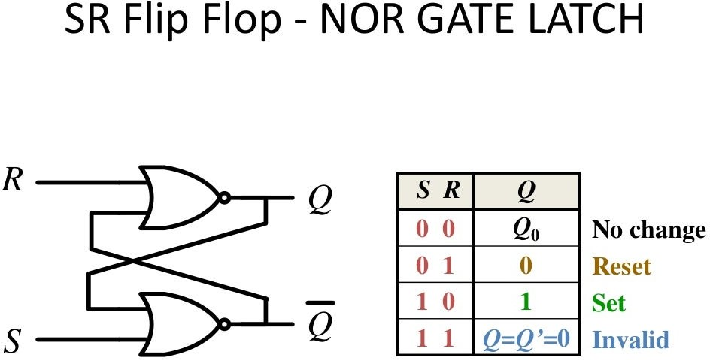

Slide 4
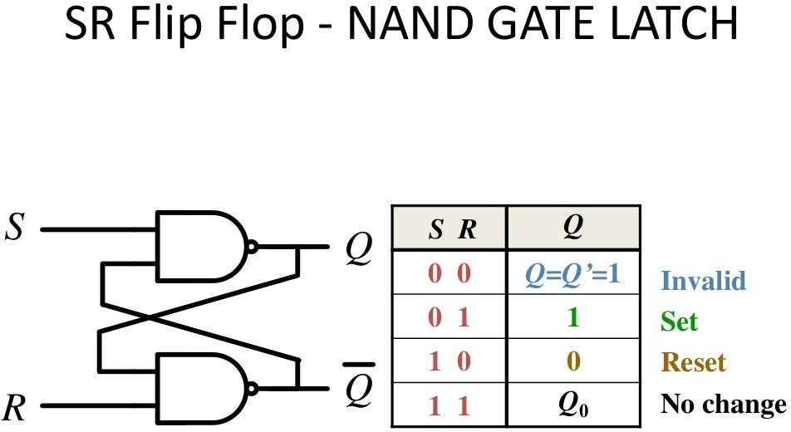

Slide 5
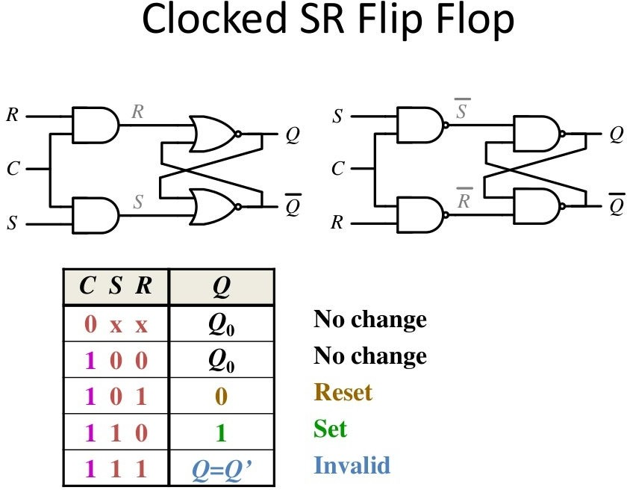

Slide 6
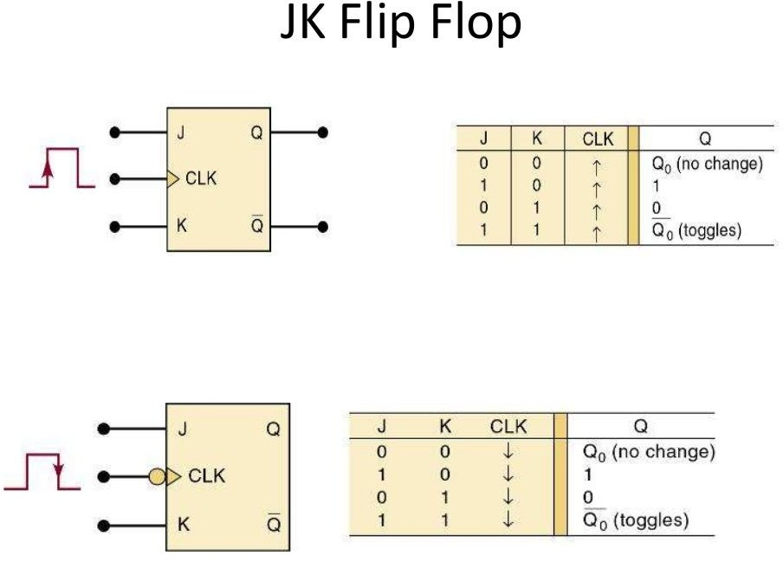

Slide 7
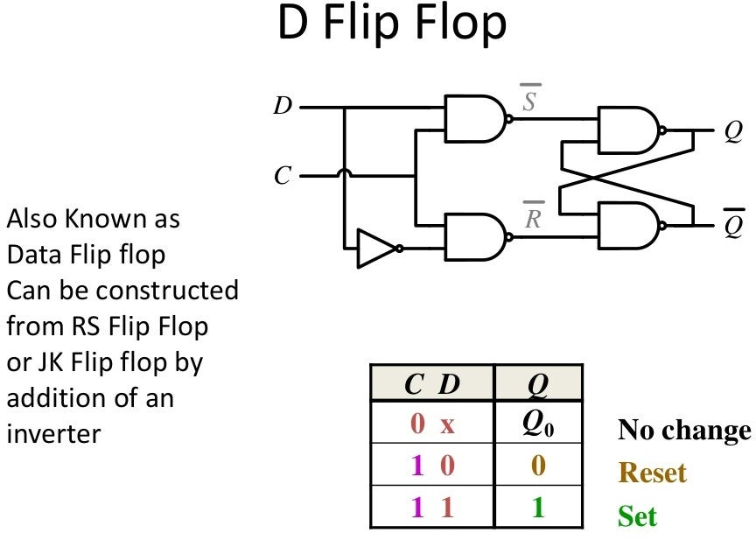

Slide 8
Master – Slave JK Flip Flop
The Master-Slave Flip-Flop is basically a combination of two JK flip-flops connected together in a series configuration. Out of these, one acts as the “master” and the other as a “slave”.
The output from the master flip flop is connected to the two inputs of the slave flip flop whose output is fed back to inputs of the master flip flop.
In addition to these two flip-flops, the circuit also includes an inverter. The inverter is connected to clock pulse in such a way that the inverted clock pulse is given to the slave flip-flop. In other words if CP=0 for a master flip-flop, then CP=1 for a slave flip-flop and if CP=1 for master flip flop then it becomes 0 for slave flip flop.

Slide 9
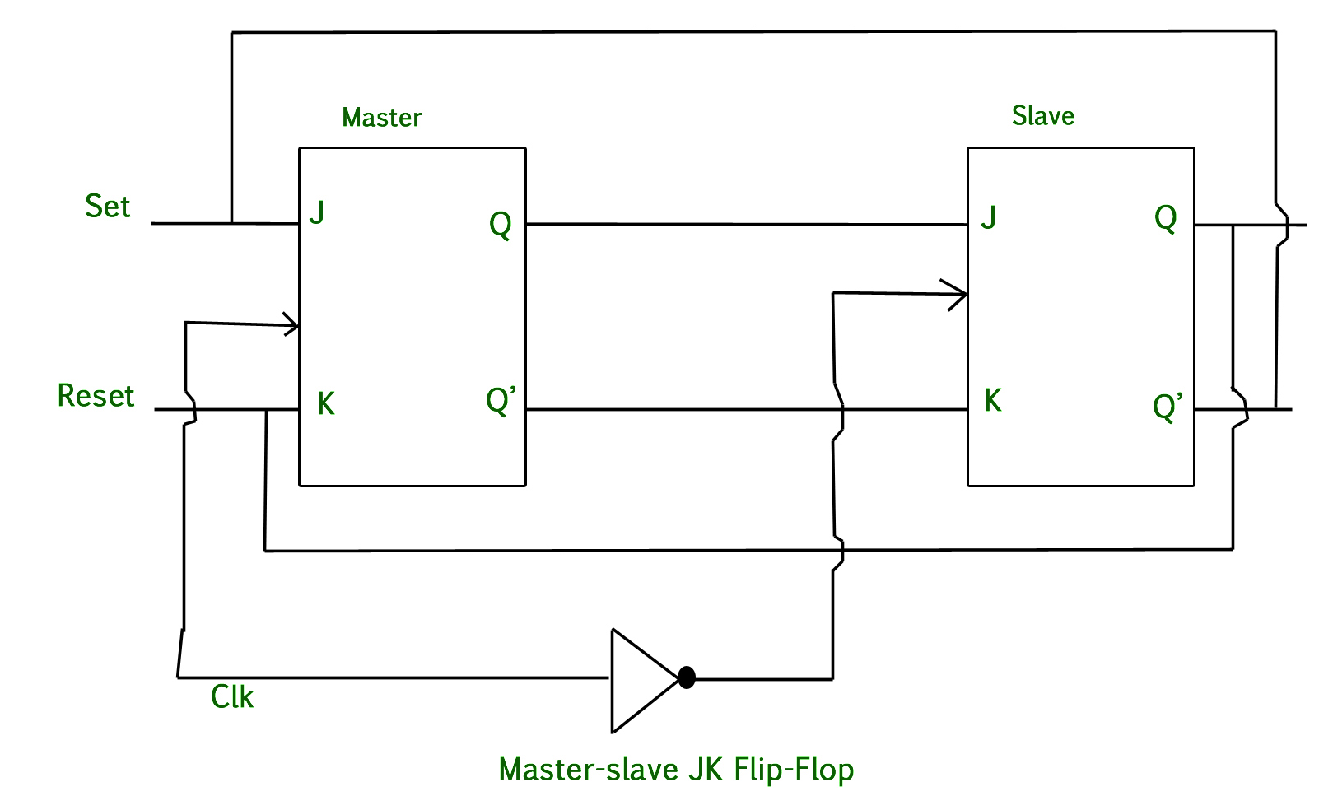
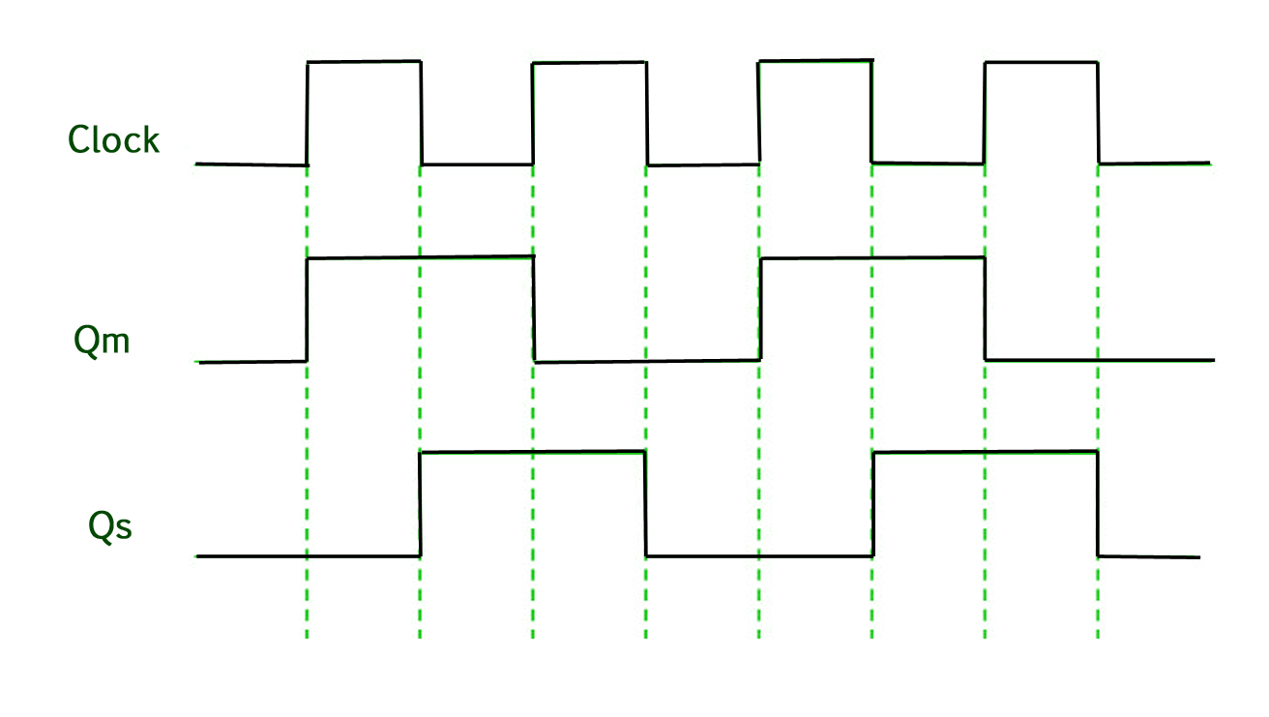
Timing Diagram of master slave JK flip flop

Slide 10
Counters
Counter is a sequential circuit. A digital circuit which is used for a counting pulses is known as counter. Counter is the widest application of flip-flops. It is a group of flip-flops with a clock signal applied.
Counters are used not only for counting but also for measuring frequency and time.
Counters are specially designed synchronous sequential circuits in which the state of the counter is equal to the count held in the circuit by the flip flops.
Counters are of two types.
Asynchronous or ripple counters.
Synchronous counters.

Slide 11
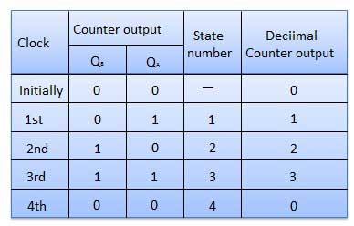
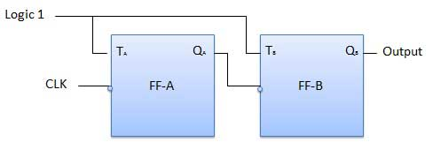
Asynchronous or ripple counters :
The logic diagram of a 2-bit ripple up counter is shown below. The toggle (T) flip-flop are being used. But we can use the JK flip-flop also with J and K connected permanently to logic 1. External clock is applied to the clock input of flip-flop A and Q_{A} output is applied to the clock input of the next flip-flop i.e. FF-B.

Slide 12
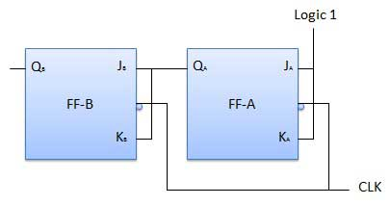
Synchronous counters :
If the "clock" pulses are applied to all the flip-flops in a counter simultaneously, then such a counter is called as synchronous counter.
2-bit Synchronous up counter
The J_{A} and K_{A} inputs of FF-A are tied to logic 1. So FF-A will work as a toggle flip-flop. The J_{B} and K_{B} inputs are connected to Q_{A}.

Slide 13
Synchronous Up Counter :
A 4-bit Synchronous up counter start to count from 0 (0000 in binary) and increment or count upwards to 15 (1111 in binary) and then start new counting cycle by getting reset.
Its operating frequency is much higher than the same range Asynchronous counter. Also, there is no propagation delay in the synchronous counter just because all flip-flops or counter stage is in parallel clock source and the clock triggers all counters at the same time.

Slide 14
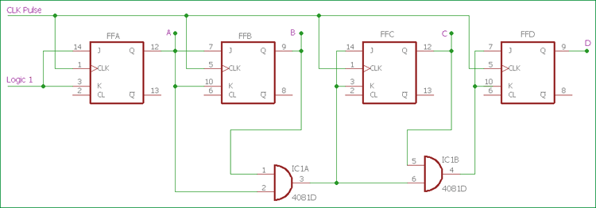
Fig. Synchronous Up Counter

Slide 15
Synchronous Down Counter :
A 4-bit Synchronous down counter start to count from 15 (1111 in binary) and decrement or count downwards to 0 or 0000 and after that it will start a new counting cycle by getting reset.
In synchronous down counter, the AND Gate input is changed. First Flip-flop FFA input is same as we used in previous Synchronous up counter.
Instead of directly feeding the output of the first flip-flop to the next subsequent flip-flop, we are using inverted output pin which is used to give J and K input across next flip-flop FFB and also used as input pin across the AND gate.
Same as like the previous circuit, two AND gates are providing necessary logic to the next two Flip-flops FFC and FFD.

Slide 16
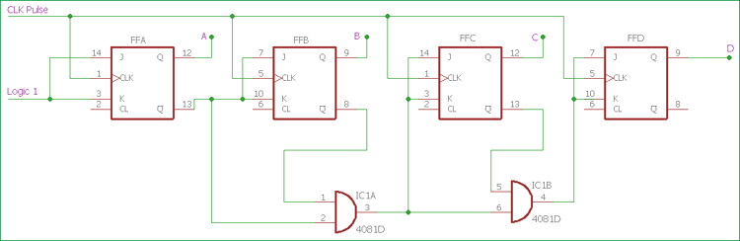
Fig. Synchronous Down Counter

Slide 17
Modulus-N Counters
Modulus Counters, or simply MOD counters, are defined based on the number of states that the counter will sequence through before returning back to its original value.
For example,
a 2-bit counter that counts from 00₂ to 11₂ in binary, that is 0 to 3 in decimal, has a modulus value of 4 ( 00 → 1 → 10 → 11, and return back to 00 ) so would therefore be called a modulo-4, or mod-4, counter. Note also that it has taken four clock pulses to get from 00 to 11.
As in this simple example there are only two bits, ( n = 2 ) then the maximum number of possible output states (maximum modulus) for the counter is: 2^{n} = 2² or 4.
Therefore, a “Mod-N” counter will require “N” number of flip-flops connected together to count a single data bit while providing 2^{n} different output states, (n is the number of bits). Note that N is always a whole integer value.

Slide 18
Types of Modulo-N Counter
Modulo -2 counter :
Technically as well as being a 1-bit storage device, a single flip-flop on its own could be thought of as a MOD-2 counter, as it has a single output resulting in a count of two, either a 0 or 1, on the application of the clock signal. But a single flip-flop on its own produces a limited counting sequence, so by connecting together more flip-flops to form a chain, we can increase the counting capacity and construct a MOD counter of any value.
Modulo -4 Counter :
If a single flip-flop can be considered as a modulo-2 or MOD-2 counter, then adding a second flip-flop would give us a MOD-4 counter allowing it to count in four discrete steps. The overall effect would be to divide the original clock input signal by four. Then the binary sequence for this 2-bit MOD-4 counter would be: 00, 01, 10, and 11 as shown.

Slide 19
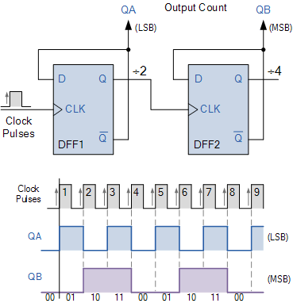
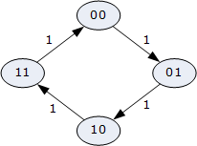
Modulo-4 Counter and Timing Diagram
lock Pulse | Present State |  |  | Next State |  | State Diagram
 | Q_{B} | Q_{A} |  | Q_{B} | Q_{A}
0 (start) | 0 | 0 | ⇒ | 0 | 1
1 | 0 | 1 | ⇒ | 1 | 0
2 | 1 | 0 | ⇒ | 1 | 1
3 | 1 | 1 | ⇒ | 0 | 0
4 (repeat) | 0 | 0 | ⇒ | 0 | 1
Fig. Modulo-4 Truth Table

Slide 20
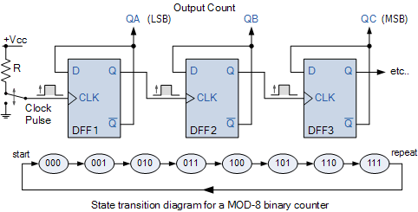
Modulo – 8 Counter :
By adding another flip-flop onto the end of a MOD-4 counter to produce a MOD-8 counter giving us a 2³ binary sequence of counting from 000 up to 111, before resetting back to 000. A fourth flip-flop would make a MOD-16 counter and so on, in fact we could go on adding extra flip-flops for as long as we wanted

Slide 21

Modulo – 5 counter :
As we want to construct a MOD-5 counter, we need to modify the 3-bit (Mod-8) counter circuit so that it will reset itself back to zero after a count of 5. That is a count sequence of: 1→2→3→4→5→reset, and so on.
We can decode this output state of 101 (5) to give us a signal to clear (Clr) the counter back to zero with the help of a 3-input AND gate (TTL 74LS11) and an inverter or NOT gate, (TTL 74LS04).
The output of the 3-input AND gate will therefore be at logic level “0” (LOW) for any combinations of the inputs, other than the input sequence we want.
While it appears that the counter counts up to the 101 state, when the asynchronous count sequence reaches the next binary state of 101 (5), the combinational logic decoding circuit will detect this 101 condition, so the AND gate will produce a logic level “1” (HIGH) output resetting the counter back to its initial zero state. Thus the counter only remains in this 101 temporary state for only a few nanoseconds before it resets back to 000.
When the output from the decoding circuit is LOW, it has no effect on the counting sequence.

Slide 22
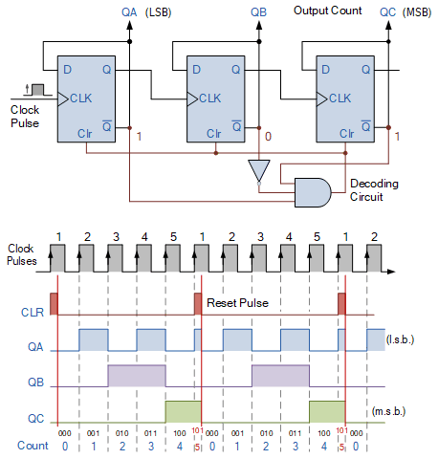
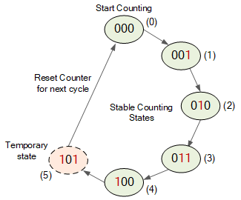
Modulus 5 Counters ,Timing Diagram & State Diagram

Slide 23
Modulo – 10 Counter :
It is an example of a modulo-m counter circuit which uses external combinational circuits to produce a counter with a modulus of 10 is the Decade Counter. Decade (divide-by-10) counters such as the TTL 74LS90, have 10 states in its counting sequence making it suitable for human interfacing where a digital display is required.
The decade counter has four outputs producing a 4-bit binary number and by using external AND and OR gates we can detect the occurrence of the 9th counting state to reset the counter back to zero. As with other mod counters, it receives an input clock pulse, one by one, and counts up from 0 to 9 repeatedly.
Once it reaches the count 9 (1001 in binary), the counter goes back to 0000 instead of continuing on to 1010. The basic circuit of a decade counter can be made from JK flip-flops (TTL 74LS73) that switch state on the negative trailing-edge of the clock signal

Slide 24
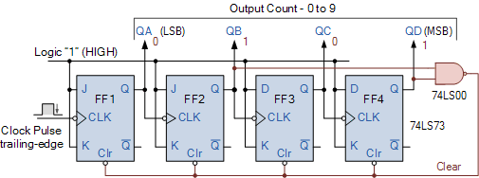
Modulo – 10 Counter Diagram

